Slide 1

Assignment 6 — Signature Assignment Group Presentation
ALY6070: Communication and Visualization for Data Analytics
Instructor: Prof. Dvorkis, Yoni
Date: January 30, 2022
By,
Vatsal Shah
Vedant Oak
Suprit Mistry
Mirav Parekh
Sanjana Rajesh Chaudhari

Slide 2

Table Of Contents
Introduction
Current Education system
Youth Literacy rates
Youth Out of School
Mobile and Internet Usage
Conclusion

Slide 3
Introduction
According to UNESCO data, the global literacy rate for all men is 90.0 percent and 82.7 percent for all females. The rate varies around the world, with wealthy countries reporting 99.2 percent (2019), South and West Asia 70.2 percent (2019), and Africa 64.0 percent (2019). Many households are unable to absorb the fees of their children's education due to the continent's rising poverty levels. As a result, Africa's enrollment rate is low when compared to the global average, resulting in poor literacy rates. Around 38 percent of adults in Africa are illiterate, with women accounting for 66 percent of this group.
To put it another way, one-third of those aged 15 and up couldn't read or write. In comparison, the illiteracy rate in 1984 was 49 percent.

Slide 4
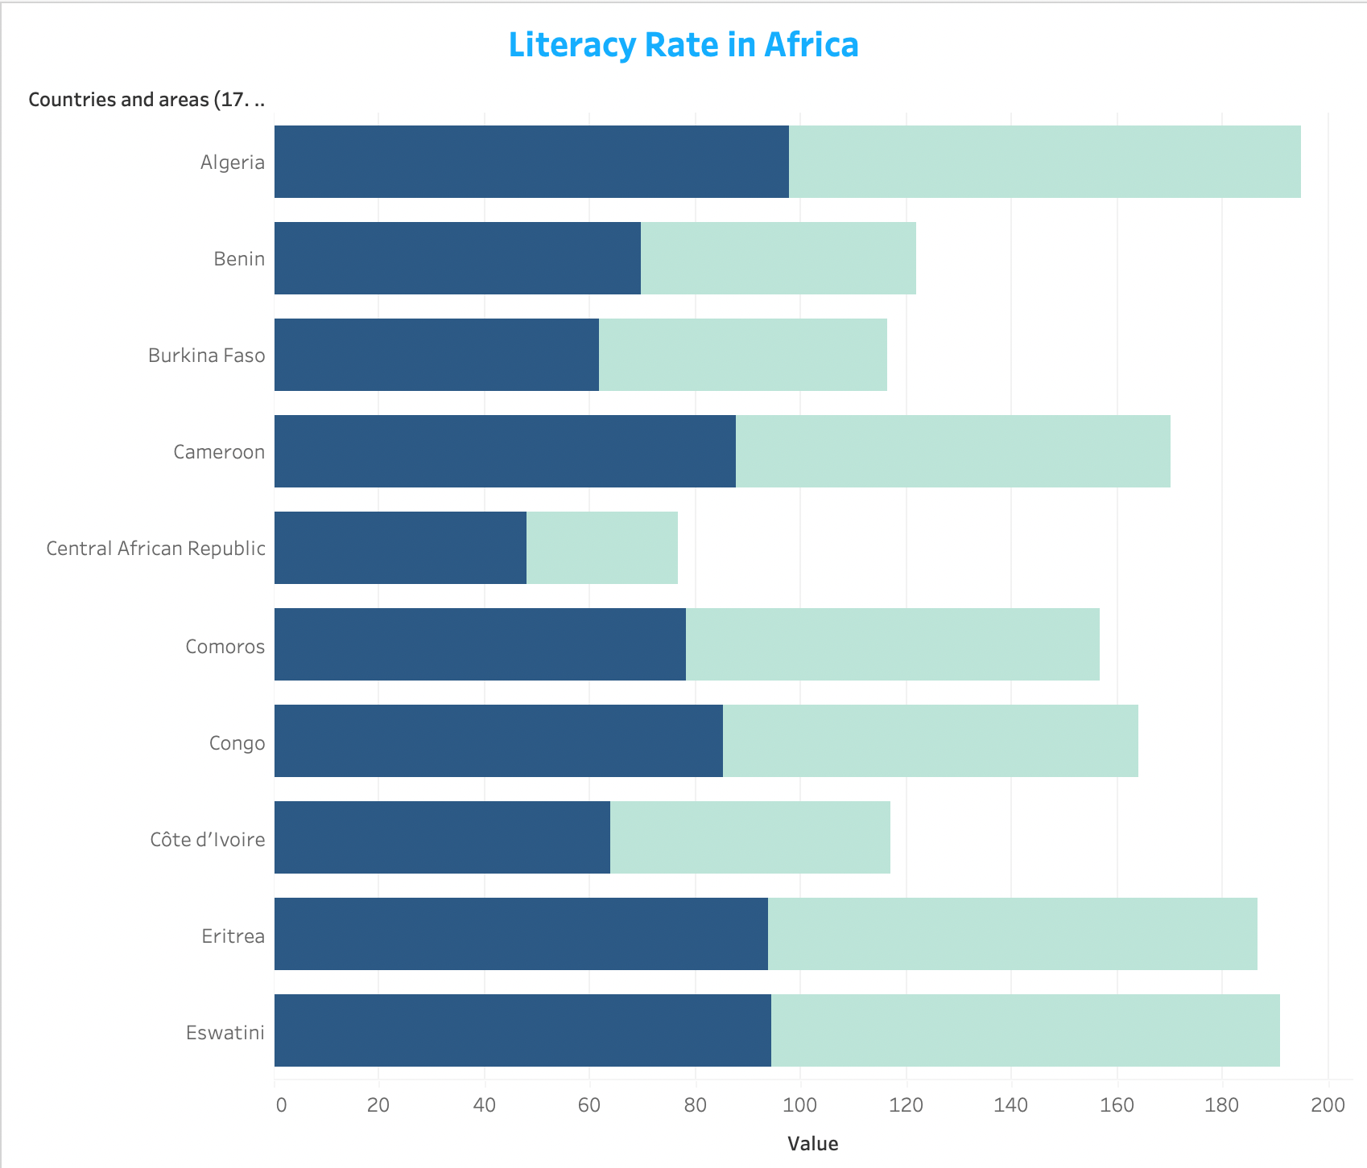
Youth Literacy Rates:
Africa had both countries with high literacy rates and countries with relatively low literacy rates. The greatest literacy rates are found in Libya, Tunisia, South Africa, Zimbabwe, and Equatorial Guinea.
Guinea, Central African Republic, Benin, and South Sudan are at the bottom of the list, with literacy rates of less comparatively.

Slide 5
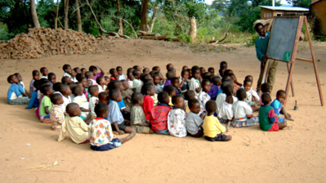
Education System
In rural areas, primary school enrollment drops dramatically, and the number of girls enrolled in school is often smaller than the number of boys. In most African countries, all children are compelled to attend primary school until they reach a particular age.
However, in many localities, only around half of the primary school students complete the whole course of study, and in certain areas, more than 90% of primary school kids repeat at most one grade.
In the majority of the continent's countries, there is no constant enrollment for schooling. Countries like Malta, Kenya, and Morocco have demonstrated a strong commitment to raising literacy rates. Other countries have high pre-primary enrollment rates, but low elementary and high school enrollments. In general, Africans have expressed an interest in enrolling their children in elementary school rather than pre-primary or secondary school.

Slide 6
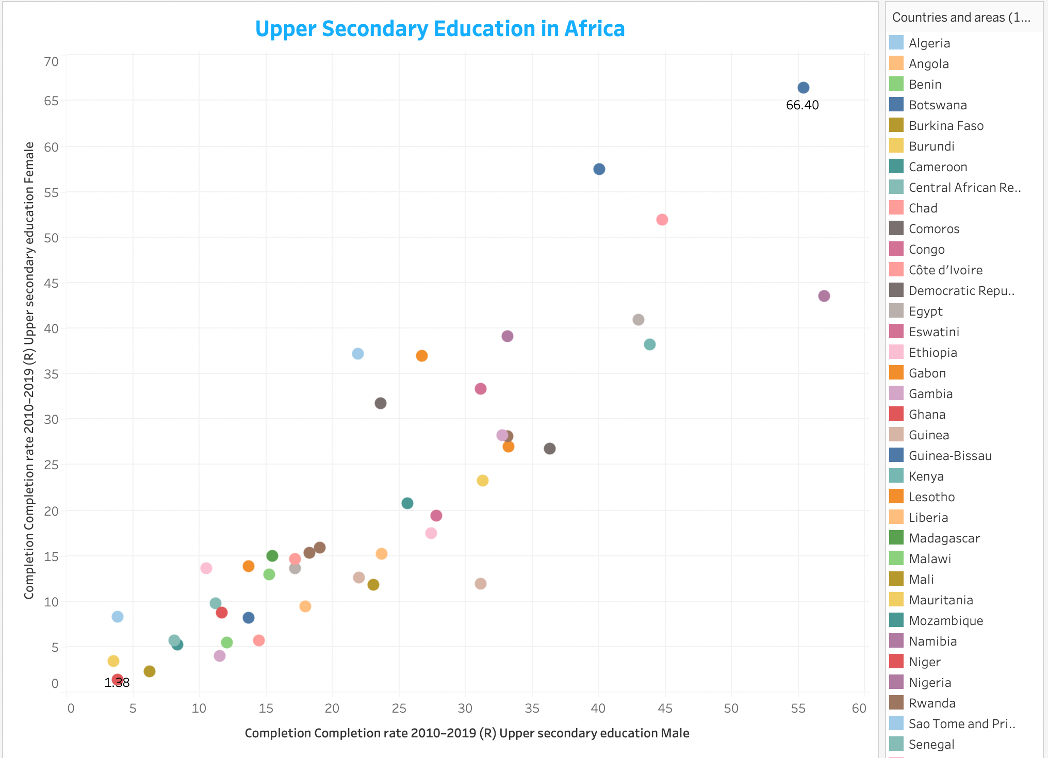
Upper Secondary Education in Africa:

Slide 7
Student Out of School at Primary school age:
Due to poor economic situations, many children in various African countries begin their education in pre-primary or primary school and drop out before completing their education.
In rural areas, primary school attendance falls dramatically, and the number of females in school is often smaller than the number of boys.

Slide 8
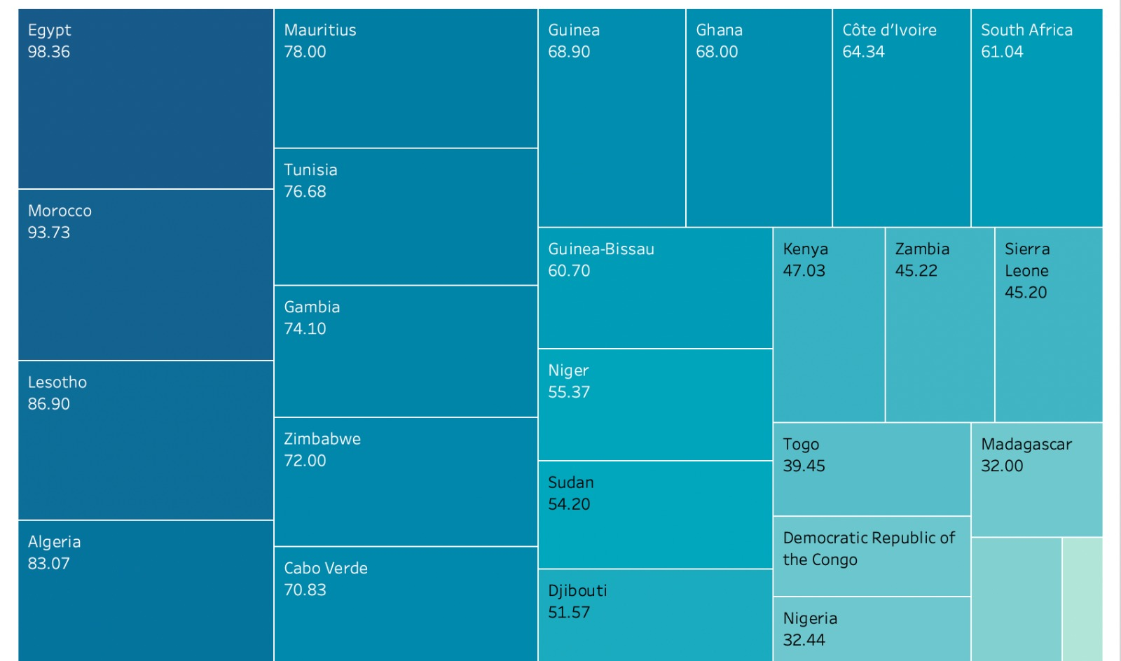
Mobile Phone Users- Female
The use of mobile phones facilitates learning and knowledge acquisition.
Similarly, the visualization depicts the total number of mobile phone subscribers in Africa as a whole.

Slide 9
The majority of African countries have limited or no internet access. The graph on the right shows the number of Internet users per 100 inhabitants in 2014. Malta is at the top of the list of countries with the most internet users (about 73 percent ).
Internet Users:

Slide 10
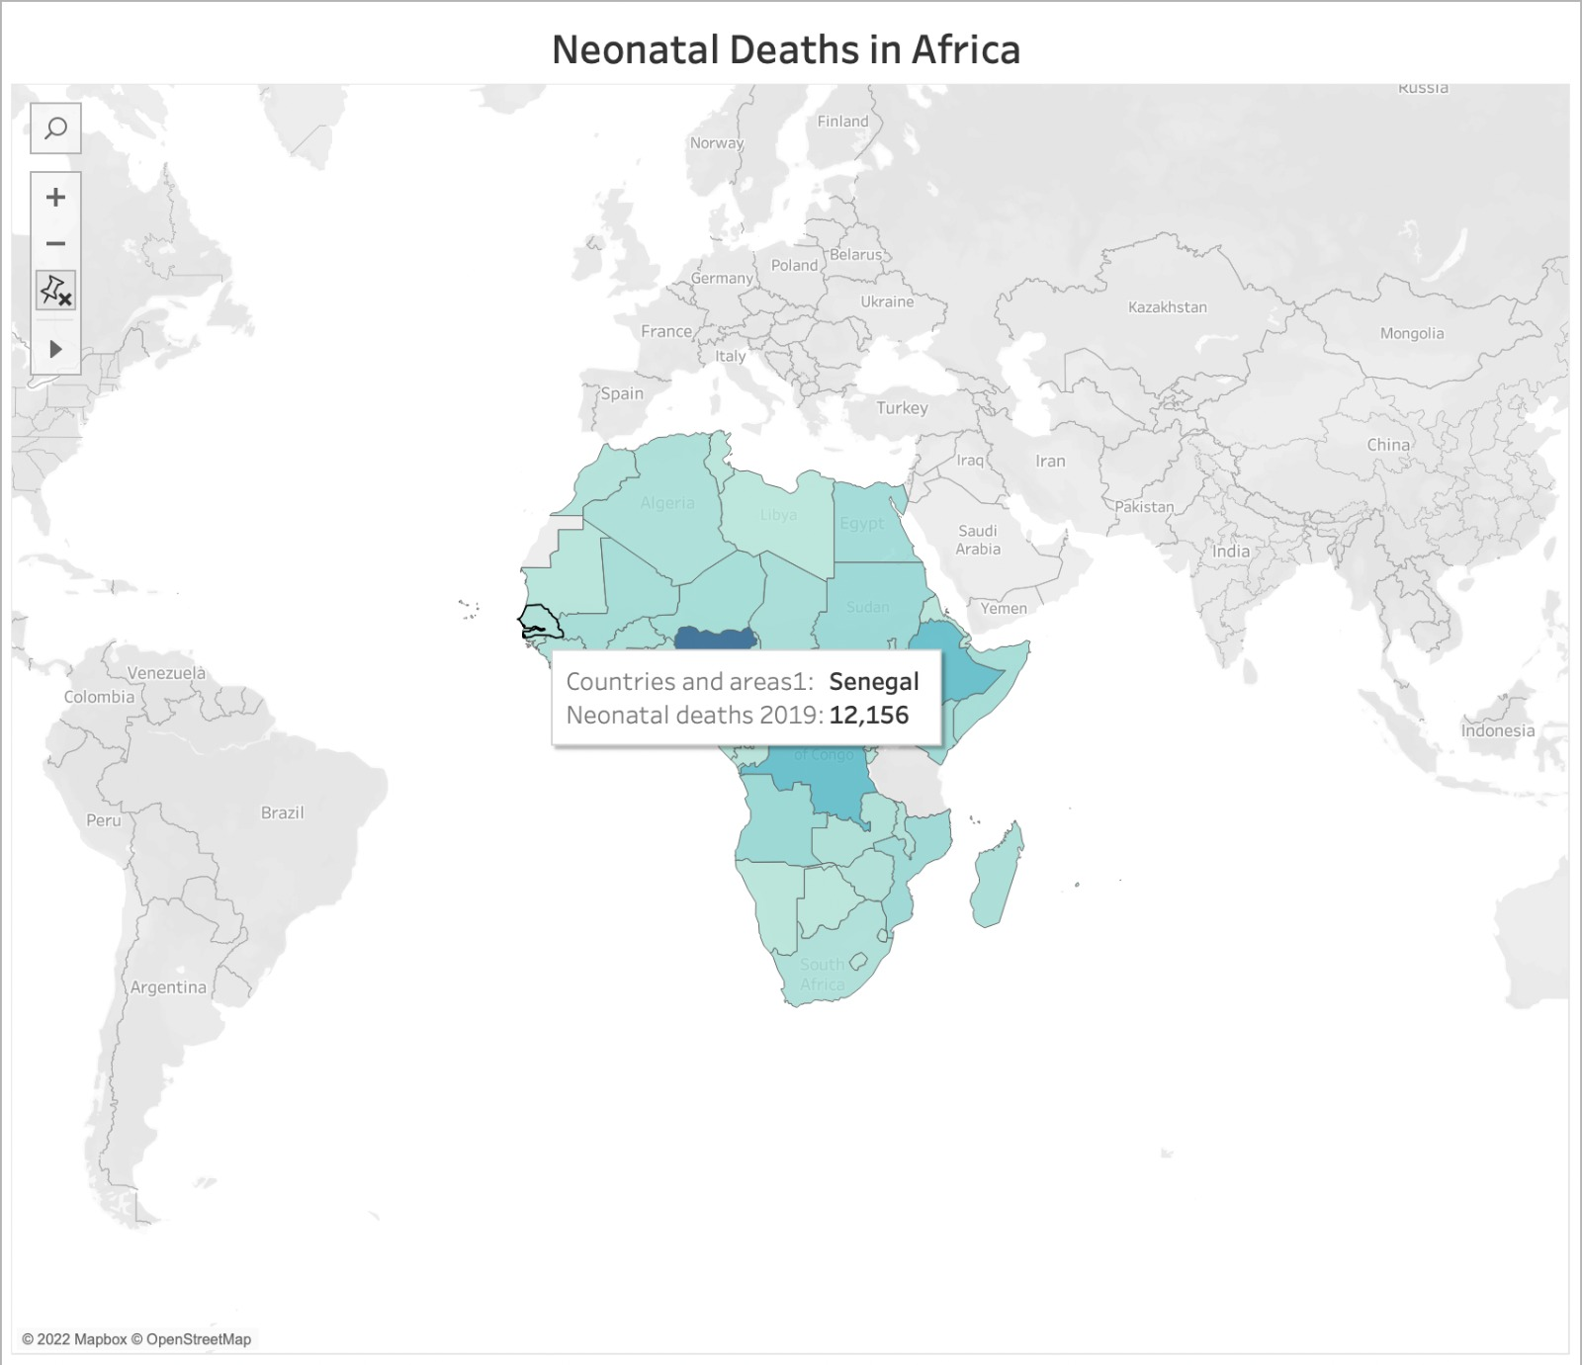
Neonatal Deaths in Africa:

Slide 11
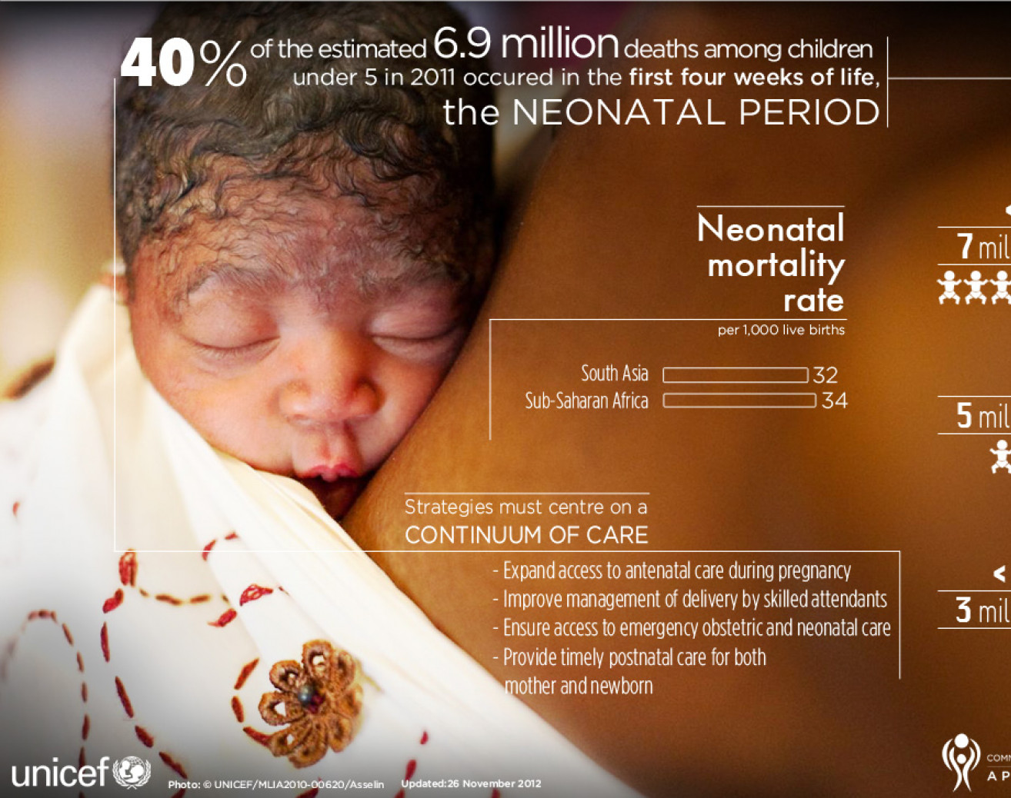
The first 28 days of life – the neonatal period – is the most vulnerable time for a child’s survival. Globally, 2.4 million children died in the first month of life in 2020 – approximately 6,500 neonatal deaths every day – with about a third of all neonatal deaths occurring within the first day after birth, and close to three-quarters occurring within the first week of life. Cabo Verde is the lowest at 94 and Nigeria the highest at 269,897

Slide 12
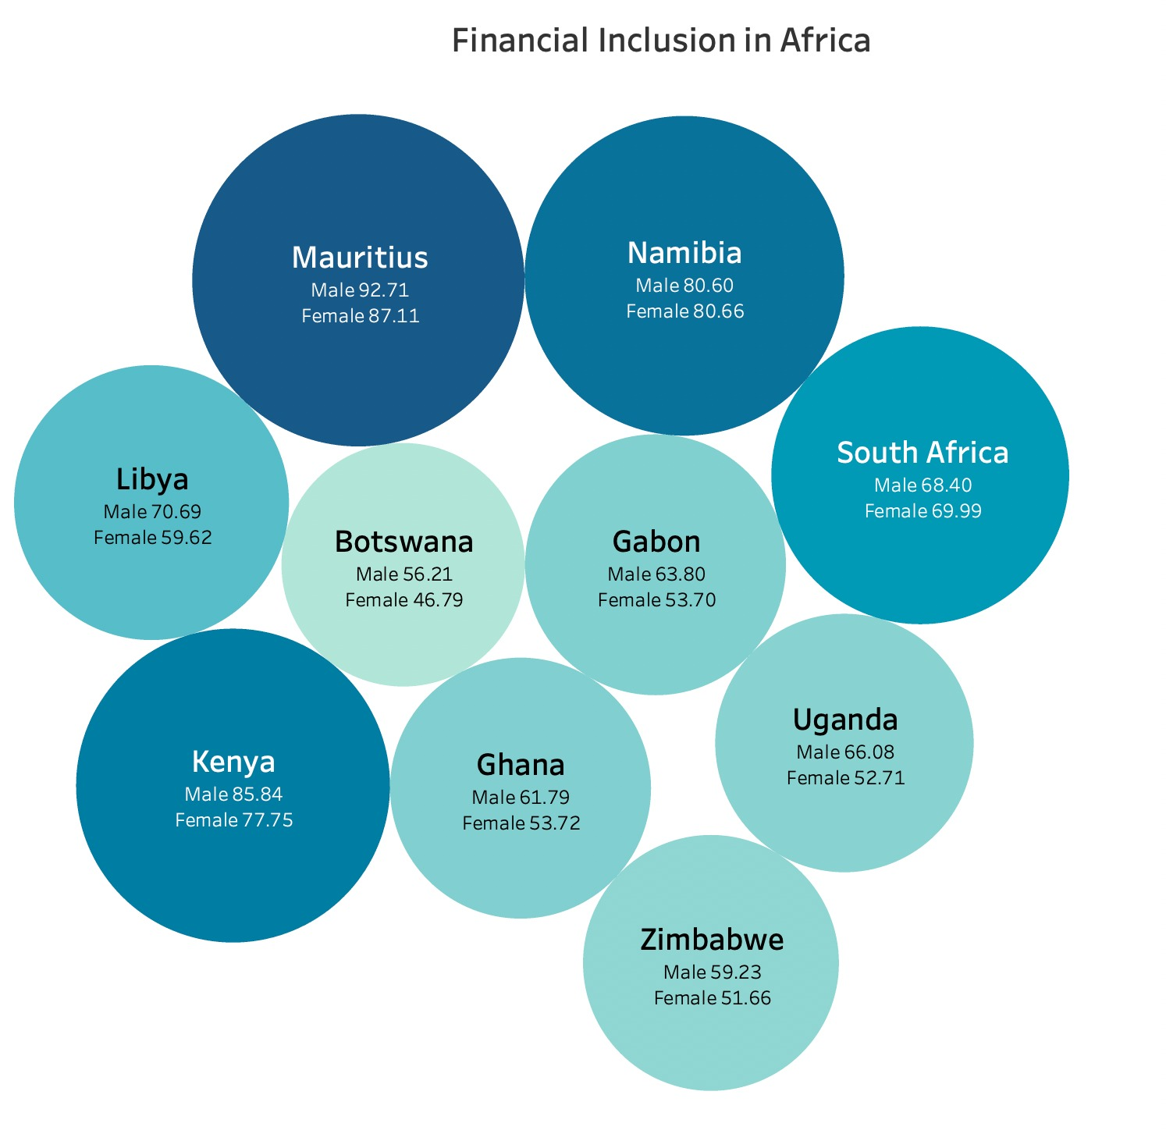
Financial Inclusion in Africa:

Slide 13
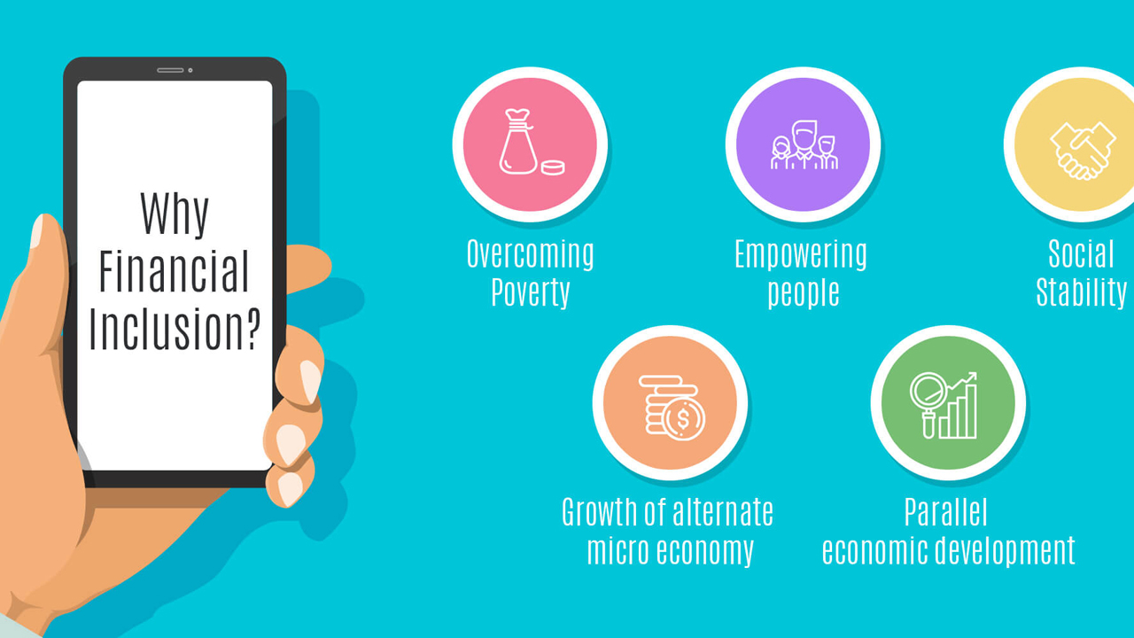
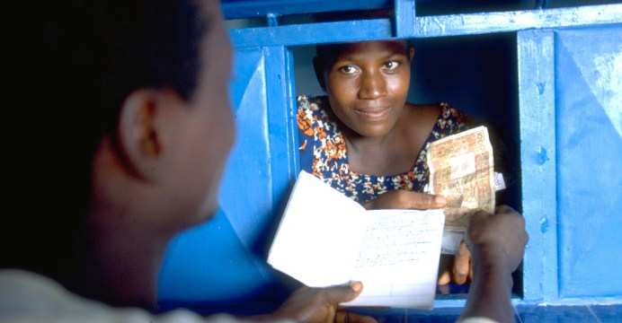

Slide 14

Conclusion:
Education plays a vital part in one’s life. With the help of mobile phones, Internet one can able to understand and know things better and more efficiently.

